Slide 2


Build and Run Enterprise Spring Apps at Scale
Hands-on workshop
April 26, 2023
Asir Selvasingh
Microsoft
Adib Saikali
VMware
Morgan Stanley, Bengaluru

Slide 3

Part 0
Let’s get started

Slide 4
Azure 101 for Spring Developers
45 mins
Notes:
OPTIONAL
Speaker: Anish

Slide 5

Azure Account
This is the email address that you provide when you create an Azure subscription.
Responsible for the monthly costs incurred by the resources in the subscription.
https://azure.microsoft.com/en-us/free/
Notes:
When you create an Azure account, you provide contact information and billing details, like a credit card. You can use the same Azure account for multiple subscriptions. Each subscription is associated with only one Azure account.
Click on the link. There are services that are free for the first 12 months. You also get a $200 credit for the first 30 days in addition to the free services.

Slide 6
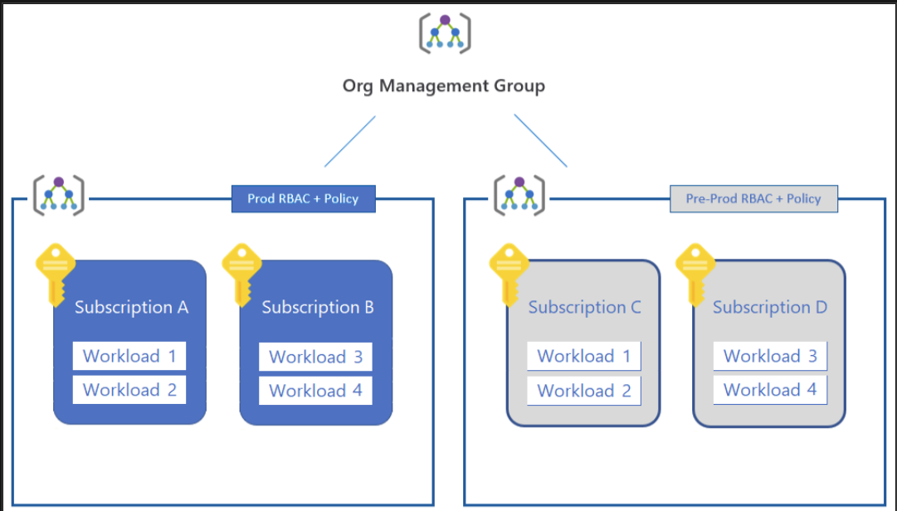
Subscriptions
A logical container for your resources (Virtual Machines, virtual networks, and storage accounts).
Each Azure resource is associated with only one subscription.
Design your cloud deployment subscriptions to meet your organization’s ownership, billing, and management capabilities.

Slide 7
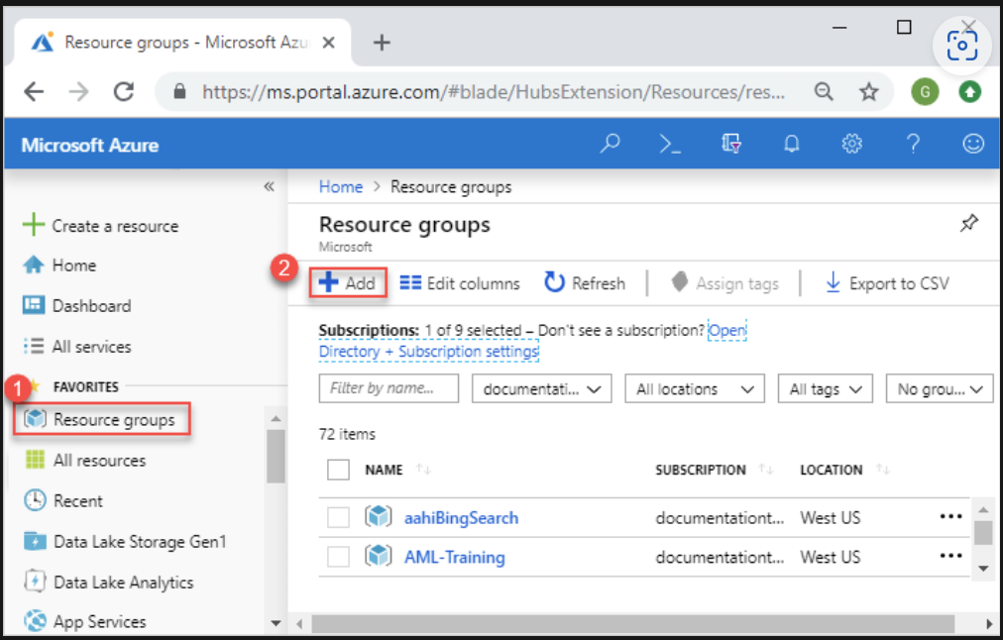
Resource Groups
Logical containers that you use to group related resources in a subscription.
Resource groups can include all the resources for a solution or only those resources that you want to manage as a group.

Slide 8
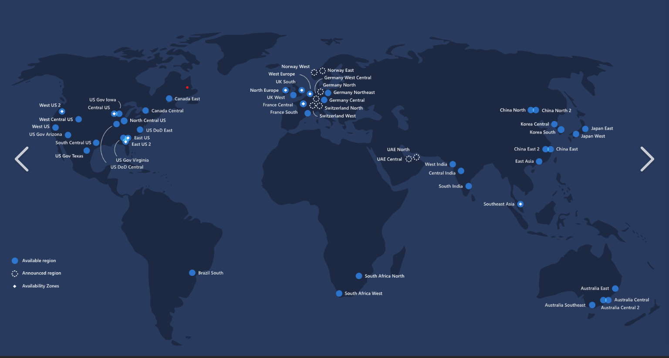
Regions
These are a set of Azure datacenters that deploy inside a latency-defined perimeter.
The datacenters connect through a dedicated, regional, low-latency network.
Most Azure resources run in a specific Azure region.
This design ensures that Azure services within any region offer the best possible performance and security.
Notes:
Datacenters are located in regions.
A region is what you choose when you create a resource.
There are multiple datacenters in a region (availability zones).

Slide 9
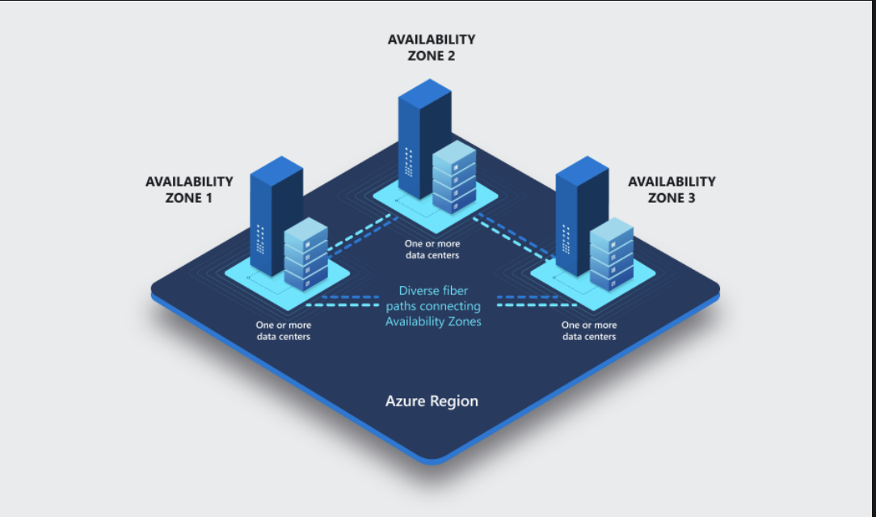
Availability Zones
Availability zones are physically separate locations within each region that are tolerant to local failures.
To ensure resiliency, a minimum of three availability zones are present in regions.
Availability zones are connected by a high-performance, low-latency network.
Notes:
Availability zones are unique physical locations within a region.
They contain their own power source, cooling capabilities, and networking.
There are some services that automatically replicate data across all the zones in the region.

Slide 10
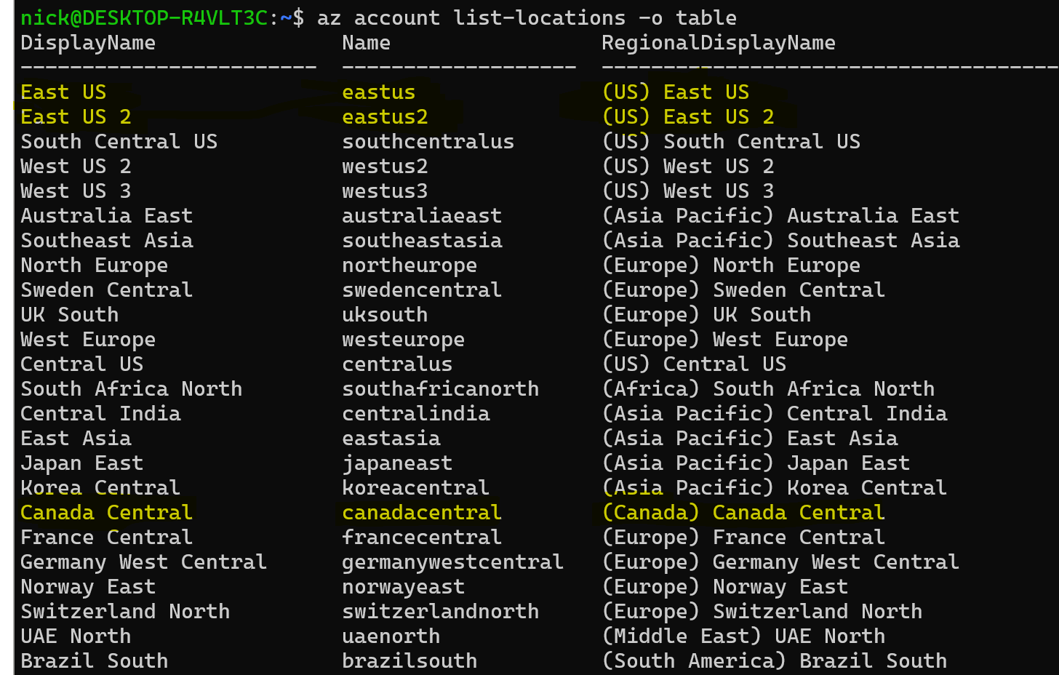
Choosing an Azure Region
Proximity to users.
Availability of services across Azure regions depends on a region’s type.
Regulation and Compliance.
https://infrastructuremap.microsoft.com/
Notes:
Typically, you want all the resources for a solution to be in the same region to minimize latency between different components of your application.
This means if your solution consists of an Azure App Service, a database, and Azure Blob storage, all these resources should be created in the same Azure region.
If you need to support users in different areas of the world, you may choose to deploy your code and data to multiple regions.
Availability of your application. If it's mission critical, you may choose to deploy your code and data to multiple regions. Acitve-Active and Active-Passive failover.

Slide 11
Demo Azure Portal & CLI
Notes:
https://portal.azure.com/
https://learn.microsoft.com/en-us/cli/azure/

Slide 12
Kickoff
Logistics, agenda, speaker introduction

Slide 13
4 parts, 4 hands-on labs, and 9 demos
Basics – building and running enterprise Spring Apps at scale.
Typical app architecture and polyglot apps.
Modern end-to-end path to production.
Q and A panel.
Socials and networking
Notes:
Speaker: Adib

Slide 14
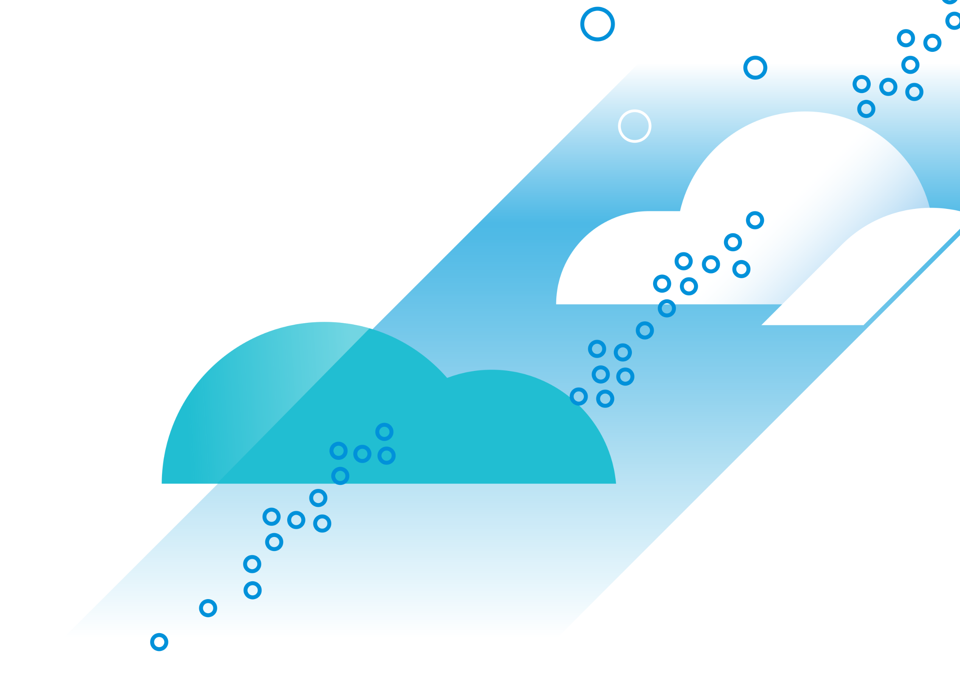
Introductions
Vivek Arya
Anish Patel
…
…
Notes:
Everyone

Slide 15
Part 1
Basics
Notes:
Speaker: Asir

Slide 16
Simplify and scale Enterprise Spring Apps in the cloud
15 mins

Slide 17

Azure Spring Apps
Fully managed service for Spring Boot Apps
Full integration into Azure’s ecosystem and services
Fully managed infrastructure
Built-in app lifecycle management
Ease of monitoring
Enterprise ready
Jointly built, operated, and supported by Microsoft and VMware
Notes:
Azure Spring Apps is a fully managed service for Spring Boot Apps that lets you focus on building and running the apps that run your business without the hassle of managing infrastructure. ​
You can simply deploy your JARs or code and Azure Spring Apps will automatically wire your apps with the Spring service runtime.
Once deployed, you can easily monitor application performance, fix errors, and rapidly improve applications.​ It is integrated into the Azure ecosystem and is enterprise ready​.
The service is jointly developed, operated, and supported by Microsoft and VMware.

Slide 18
On Kubernetes
You do not have to learn or manage Kubernetes
Notes:
Azure Spring Apps is built on Kubernetes.
The exciting part is, you get the power of Kubernetes, but you don’t have to really worry about learning or managing it.

Slide 19










Azure Spring Apps (slide 1 of 7)
Azure Spring Apps
Spring Boot Apps
Service runtime
Notes:
A few more details …
The big rectangle is Azure Spring Apps, built on K8S.
Each service instance has two dedicated Kubernetes clusters. They are managed by Azure Spring Apps and abstracted away from users.
Service runtime with managed Spring Apps components, app lifecycle, log streaming, and many more service runtime components are managed in the right side of the Kubernetes cluster.
Your apps are running in the left cluster of the diagram.
<CLICK>
Your apps can interact with any Azure service or external service or on-premises system.
<CLICK>
Logs, metrics, and alerts are available through Azure Monitor. You can monitor end-to-end, using any tools and platform of your choice.
<CLICK>
You can secure your apps using Azure Active Directory.
<CLICK>
Automate end-to-end, using your favorite tools and platforms.
<CLICK>
You can continue to use the development tools you are familiar with – IntelliJ, VS Code, Maven, Gradle. You can deploy using tools like IntelliJ and Maven.
Net-net – it is an easy way to get started, focus on your biz objectives, and everything else is taken care of for you in the cloud.
<CLICK>
Do you have to manage anything here?
No, you do not … Azure Spring Apps has absorbed all the complexities with infrastructure, hosting microservice apps, app lifecycle, managing microservices, blue green deployments, pushing logs, and metrics.
All supported by Microsoft and VMware.

Slide 20












Azure Spring Apps (slide 2 of 7)
Azure Spring Apps
Spring Boot Apps
Service runtime
Open-source client libraries, integration modules, and drivers
Data
Storage
Cache
Async communications – JMS and Kafka
Keys, secrets, and certs
Notes:
A few more details …
The big rectangle is Azure Spring Apps, built on K8S.
Each service instance has two dedicated Kubernetes clusters. They are managed by Azure Spring Apps and removed from users.
Service runtime with managed Spring Apps components, app lifecycle, log streaming, and many more service runtime components are managed in the right side of the Kubernetes cluster.
Your apps are running in the left cluster of the diagram.
<CLICK>
Your apps can interact with any Azure service or external service or on-premises system.
<CLICK>
Logs, metrics, and alerts are available through Azure Monitor. You can monitor end-to-end, using any tools and platform of your choice.
<CLICK>
You can secure your apps using Azure Active Directory.
<CLICK>
Automate end-to-end, using your favorite tools and platforms.
<CLICK>
You can continue to use the development tools you are familiar with – IntelliJ, VS Code, Maven, Gradle. You can deploy using tools like IntelliJ and Maven.
Net-ne – it is an easy way to get started, focus on your biz objectives, and everything else is taken care of for you in the cloud.
<CLICK>
Do you have to manage anything here?
No, you do not … Azure Spring Apps has absorbed all the complexities with infrastructure, hosting microservice apps, app lifecycle, managing microservices, blue green deployments, pushing logs, and metrics.
All supported by Microsoft and VMware.

Slide 21

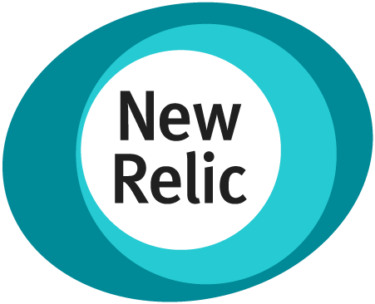
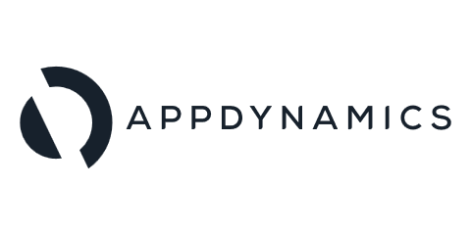

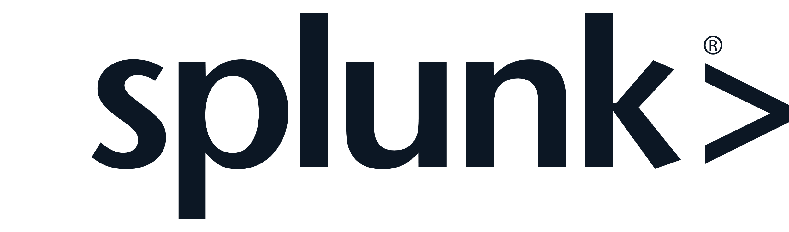
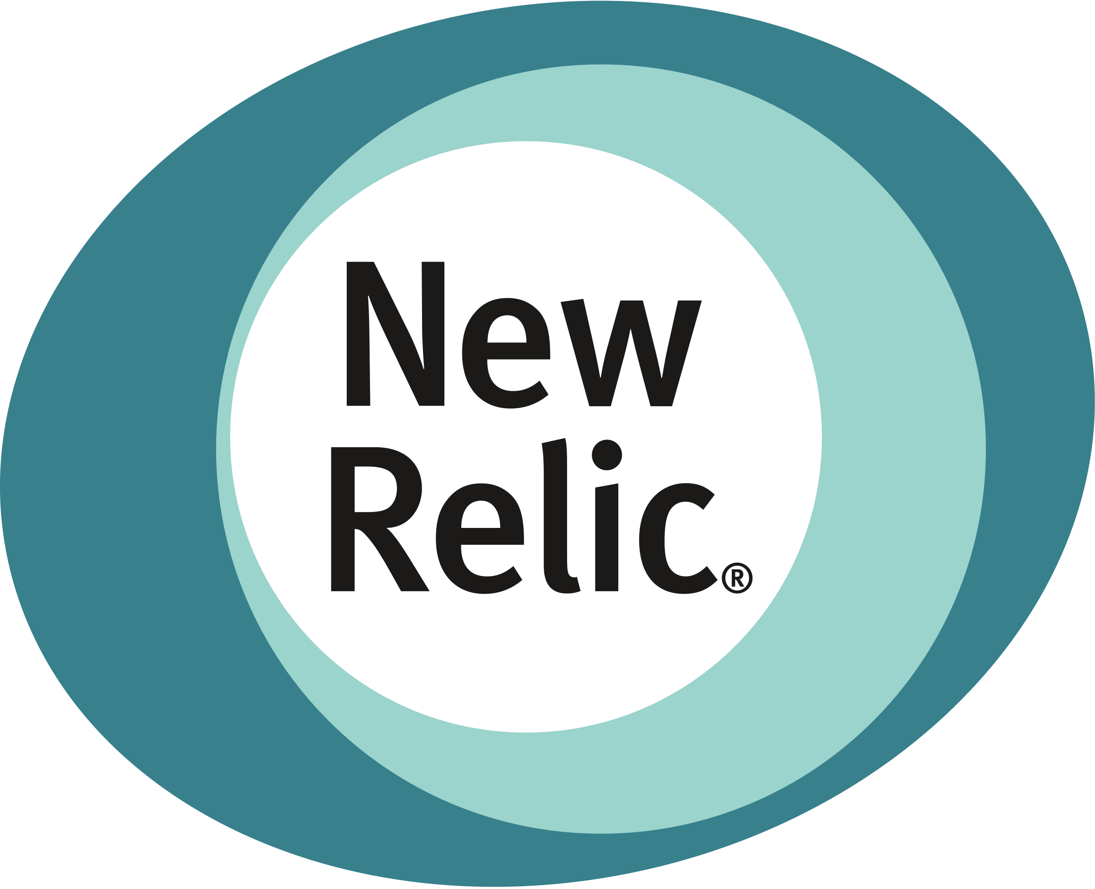
Azure Spring Apps (slide 3 of 7)
Monitor – logstream, APM, & end-to-end
Azure Spring Apps
Spring Boot Apps
Service runtime
Open-source client libraries, integration modules, and drivers
Data
Storage
Cache
Async communications – JMS and Kafka
Keys, secrets, and certs
Notes:
A few more details …
The big rectangle is Azure Spring Apps, built on K8S.
Each service instance has two dedicated Kubernetes clusters. They are managed by Azure Spring Apps and removed from users.
Service runtime with managed Spring Apps components, app lifecycle, log streaming, and many more service runtime components are managed in the right side of the Kubernetes cluster.
Your apps are running in the left cluster of the diagram.
<CLICK>
Your apps can interact with any Azure service or external service or on-premises system.
<CLICK>
Logs, metrics, and alerts are available through Azure Monitor. You can monitor end-to-end, using any tools and platform of your choice.
<CLICK>
You can secure your apps using Azure Active Directory.
<CLICK>
Automate end-to-end, using your favorite tools and platforms.
<CLICK>
You can continue to use the development tools you are familiar with – IntelliJ, VS Code, Maven, Gradle. You can deploy using tools like IntelliJ and Maven.
Net-net – it is an easy way to get started, focus on your biz objectives, and everything else is taken care of for you in the cloud.
<CLICK>
Do you have to manage anything here?
No, you do not … Azure Spring Apps has absorbed all the complexities with infrastructure, hosting microservice apps, app lifecycle, managing microservices, blue green deployments, pushing logs, and metrics.
All supported by Microsoft and VMware.

Slide 22

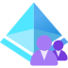
Azure Spring Apps (slide 4 of 7)
Monitor – logstream, APM, & end-to-end
Identities – end-users & machines
Azure Spring Apps
Spring Boot Apps
Service runtime
Open-source client libraries, integration modules, and drivers
Data
Storage
Cache
Async communications – JMS and Kafka
Keys, secrets, and certs
Notes:
A few more details …
The big rectangle is Azure Spring Apps, built on K8S.
Each service instance has two dedicated Kubernetes clusters. They are managed by Azure Spring Apps and removed from users.
Service runtime with managed Spring Apps components, app lifecycle, log streaming, and many more service runtime components are managed in the right side of the Kubernetes cluster.
Your apps are running in the left cluster of the diagram.
<CLICK>
Your apps can interact with any Azure service or external service or on-premises system.
<CLICK>
Logs, metrics, and alerts are available through Azure Monitor. You can monitor end-to-end, using any tools and platform of your choice.
<CLICK>
You can secure your apps using Azure Active Directory.
<CLICK>
Automate end-to-end, using your favorite tools and platforms.
<CLICK>
You can continue to use the development tools you are familiar with – IntelliJ, VS Code, Maven, Gradle. You can deploy using tools like IntelliJ and Maven.
Net-net – t is an easy way to get started, focus on your biz objectives, and everything else is taken care of for you in the cloud.
<CLICK>
Do you have to manage anything here?
No, you do not … Azure Spring Apps has absorbed all the complexities with infrastructure, hosting microservice apps, app lifecycle, managing microservices, blue green deployments, pushing logs, and metrics.
All supported by Microsoft and VMware.

Slide 23
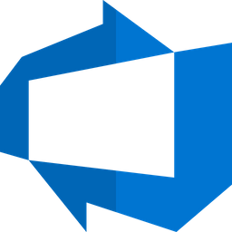







Azure Spring Apps (slide 5 of 7)
Monitor – logstream, APM, & end-to-end
Identities – end-users & machines
Automation
Azure Spring Apps
Spring Boot Apps
Service runtime
Open-source client libraries, integration modules, and drivers
Data
Storage
Cache
Async communications – JMS and Kafka
Keys, secrets, and certs
Notes:
A few more details …
The big rectangle is Azure Spring Apps, built on K8S.
Each service instance has two dedicated Kubernetes clusters. They are managed by Azure Spring Apps and removed from users.
Service runtime with managed Spring Apps components, app lifecycle, log streaming, and many more service runtime components are managed in the right side of the Kubernetes cluster.
Your apps are running in the left cluster of the diagram.
<CLICK>
Your apps can interact with any Azure service or external service or on-premises system.
<CLICK>
Logs, metrics, and alerts are available through Azure Monitor. You can monitor end-to-end, using any tools and platform of your choice.
<CLICK>
You can secure your apps using Azure Active Directory.
<CLICK>
Automate end-to-end, using your favorite tools and platforms.
<CLICK>
You can continue to use the development tools you are familiar with – IntelliJ, VS Code, Maven, Gradle. You can deploy using tools like IntelliJ and Maven.
Net-net – it is an easy way to get started, focus on your biz objectives, and everything else is taken care of for you in the cloud.
<CLICK>
Do you have to manage anything here?
No, you do not … Azure Spring Apps has absorbed all the complexities with infrastructure, hosting microservice apps, app lifecycle, managing microservices, blue green deployments, pushing logs, and metrics.
All supported by Microsoft and VMware.

Slide 24
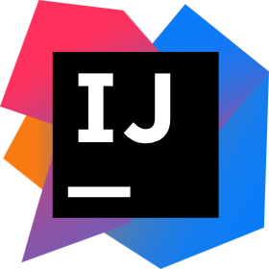

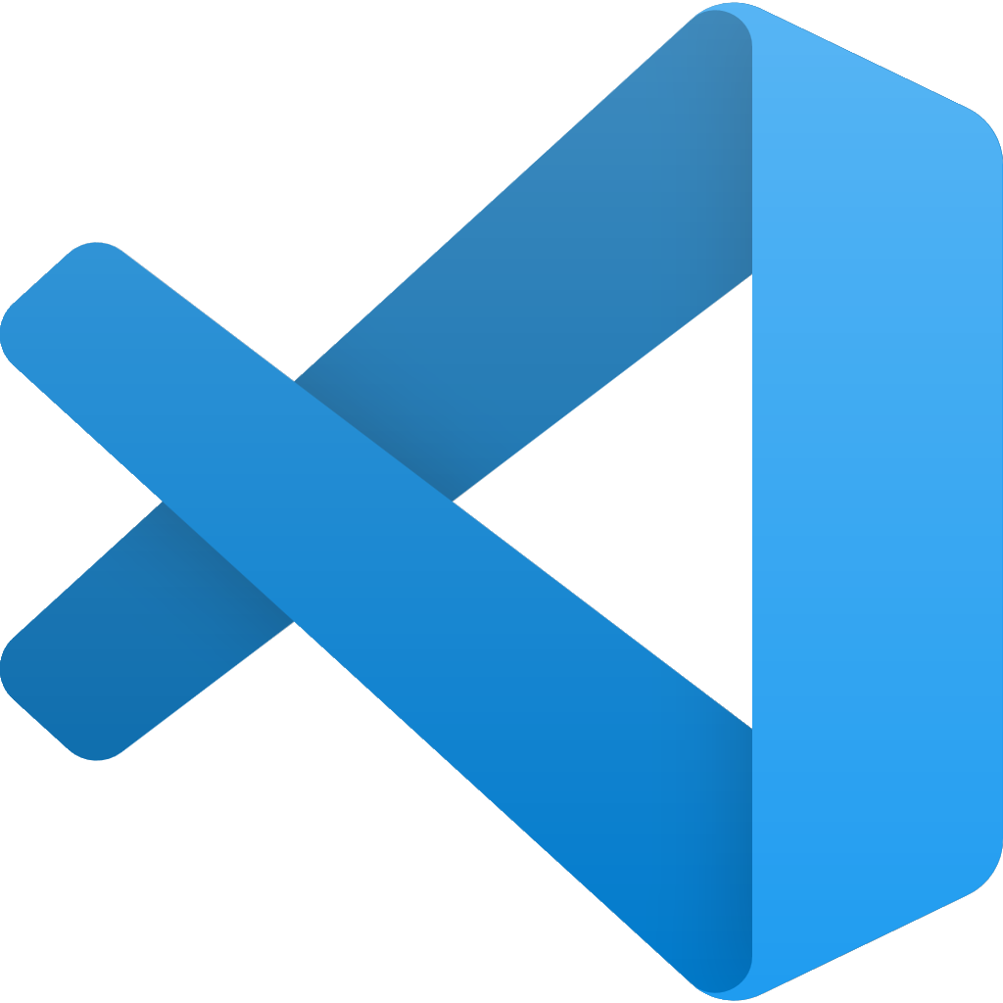

Azure Spring Apps (slide 3 of 7)
Developer experiences
Monitor – logstream, APM & end-to-end
Identities – end-users & machines
Automation
Azure Spring Apps
Spring Boot Apps
Service runtime
Open-source client libraries, integration modules, and drivers
Data
Storage
Cache
Async communications – JMS and Kafka
Keys, secrets, and certs
Notes:
A few more details …
The big rectangle is Azure Spring Apps, built on K8S.
Each service instance has two dedicated Kubernetes clusters. They are managed by Azure Spring Apps and removed from users.
Service runtime with managed Spring Apps components, app lifecycle, log streaming, and many more service runtime components are managed in the right side of the Kubernetes cluster.
Your apps are running in the left cluster of the diagram.
<CLICK>
Your apps can interact with any Azure service or external service or on-premises system.
<CLICK>
Logs, metrics, and alerts are available through Azure Monitor. You can monitor end-to-end, using any tools and platform of your choice.
<CLICK>
You can secure your apps using Azure Active Directory.
<CLICK>
Automate end-to-end, using your favorite tools and platforms.
<CLICK>
You can continue to use the development tools you are familiar with – IntelliJ, VS Code, Maven, Gradle. You can deploy using tools like IntelliJ and Maven.
Net-net – it is an easy way to get started, focus on your biz objectives, and everything else is taken care of for you in the cloud.
<CLICK>
Do you have to manage anything here?
No, you do not … Azure Spring Apps has absorbed all the complexities with infrastructure, hosting microservice apps, app lifecycle, managing microservices, blue green deployments, pushing logs, and metrics.
All supported by Microsoft and VMware.

Slide 25
Azure Spring Apps (slide 7 of 7)
Developer experiences
Monitor – logstream, APM, & end-to-end
Identities – end-users & machines
Automation
Azure Spring Apps
Spring Boot Apps
Service runtime
Open-source client libraries, integration modules, and drivers
Data
Storage
Cache
Async communications – JMS and Kafka
Keys, secrets, and certs
Notes:
A few more details …
The big rectangle is Azure Spring Apps, built on K8S.
Each service instance has two dedicated Kubernetes clusters. They are managed by Azure Spring Apps and removed from users.
Service runtime with managed Spring Apps components, app lifecycle, log streaming, and many more service runtime components are managed in the right side of the Kubernetes cluster.
Your apps are running in the left cluster of the diagram.
<CLICK>
Your apps can interact with any Azure service or external service or on-premises system.
<CLICK>
Logs, metrics, and alerts are available through Azure Monitor. You can monitor end-to-end, using any tools and platform of your choice.
<CLICK>
You can secure your apps using Azure Active Directory.
<CLICK>
Automate end-to-end, using your favorite tools and platforms.
<CLICK>
You can continue to use the development tools you are familiar with – IntelliJ, VS Code, Maven, Gradle. You can deploy using tools like IntelliJ and Maven.
Net-net – it is an easy way to get started, focus on your biz objectives, and everything else is taken care of for you in the cloud.
<CLICK>
Do you have to manage anything here?
No, you do not … Azure Spring Apps has absorbed all the complexities with infrastructure, hosting microservice apps, app lifecycle, managing microservices, blue green deployments, pushing logs, and metrics.
All supported by Microsoft and VMware.

Slide 26

Three simple operations
Create service
1
az spring create --name ${SPRING_CLOUD_SERVICE} \ --sku enterprise \ --resource-group ${RESOURCE_GROUP} \ --location ${REGION}
2
Create app
az spring app create --name ${CUSTOMERS_SERVICE}
3
Deploy app
az spring app deploy --name ${CUSTOMERS_SERVICE} | --jar-path ${CUSTOMERS_SERVICE_JAR}
Notes:
Three simple steps to get started! Just 3!
Azure Spring Apps is as simple to spin up as it is powerful, and it follows three simple steps:
First, create a service instance.
Next, create an app within the service.
And finally, deploy the application binaries or source to Azure Spring Apps.
Azure does the hard work. All you have to do is point it in the right direction.
It really is that simple!

